Slide 1
CPT, OPT and STEM OPT
F1 International Students
UFIC International Student Services
September 2021

Slide 2
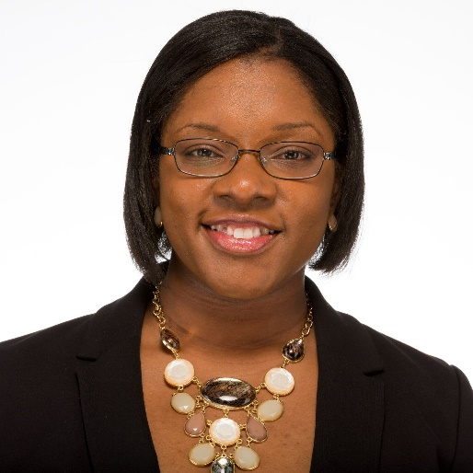
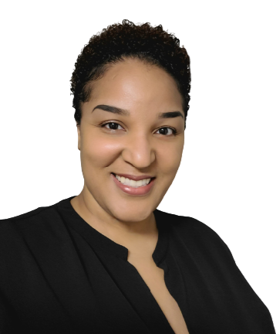
Keira Simmonds
Career Connections Center
Sr. Assistant Director for Campus Engagement
KSimmonds@ufsa.ufl.edu
Martine Angrand
International Student Services
Director, F1 International Student Compliance Services
Contact Your Advisor: https://internationalcenter.ufl.edu/ f-1-student/contact-advisor
Notes:
Friday, 3:00-4:30pm
Will be updated depending on who is presenting
Name
Title
Education
Hometown
Six word story
Strengths
Twitter handle (optional)

Slide 3
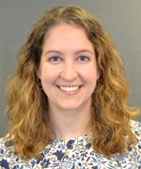
Keira Simmonds
Career Connections Center
Sr. Assistant Director for Campus Engagement
KSimmonds@ufsa.ufl.edu
Kristin Fischer
International Student Services
F1 International Student Advisor, Surnames U-Z
Contact Your Advisor: https://internationalcenter.ufl.edu/ f-1-student/contact-advisor
Notes:
Friday, 3:00-4:30pm
Will be updated depending on who is presenting
Name
Title
Education
Hometown
Six word story
Strengths
Twitter handle (optional)

Slide 4
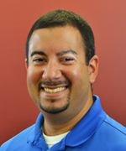
Keira Simmonds
Career Connections Center
Sr. Assistant Director for Campus Engagement
KSimmonds@ufsa.ufl.edu
Steve Ghulamani
International Student Services
F1 International Student Advisor, Surnames K & L
Contact Your Advisor: https://internationalcenter.ufl.edu/ f-1-student/contact-advisor
Notes:
Friday, 3:00-4:30pm
Will be updated depending on who is presenting
Name
Title
Education
Hometown
Six word story
Strengths
Twitter handle (optional)

Slide 5
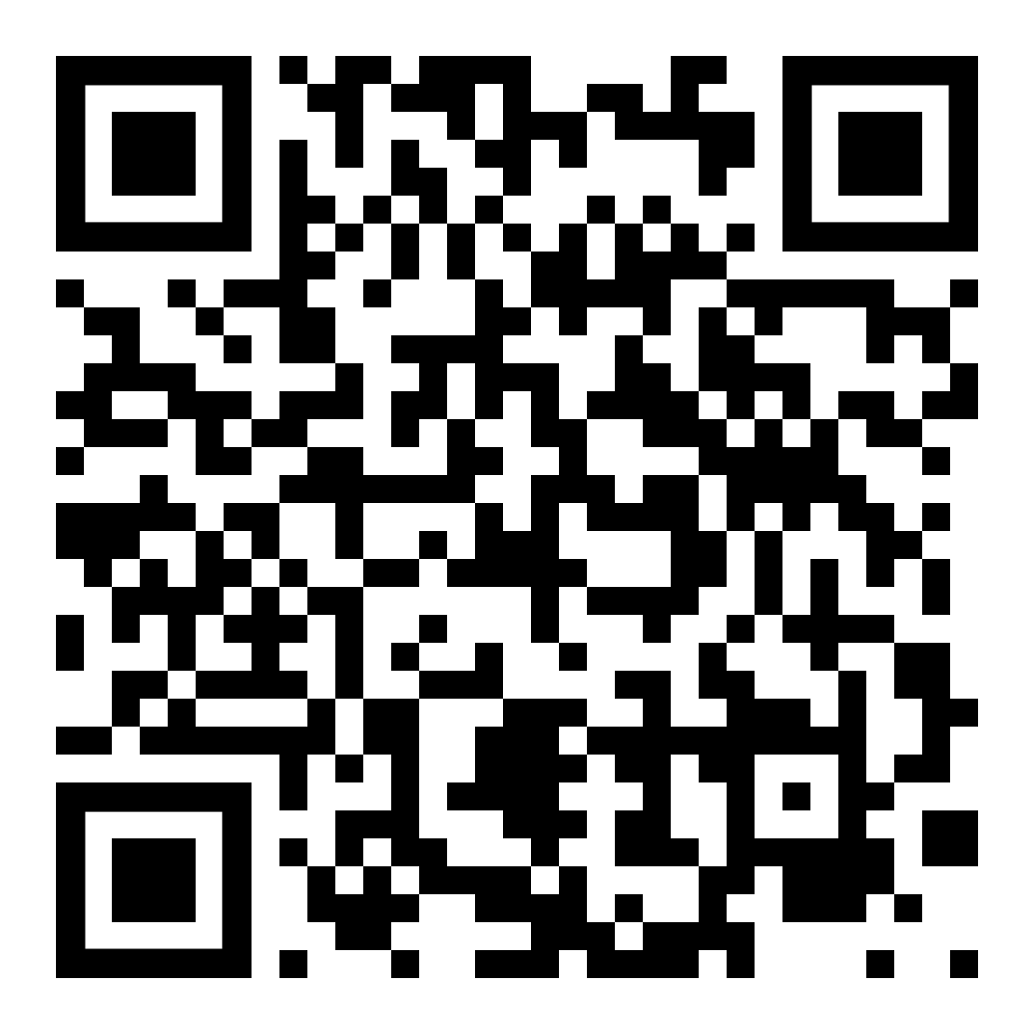
Schedule a Career Planning Appointment
www.career.ufl.edu

Slide 6
Virtual Express Drop-In
Quick Individual Help!
Monday – Friday
11 a.m. – 3 p.m.
Connect with a Career Ambassador to get help with your resume, cover letter, or a mock interview
No appointments needed!
https://career.ufl.edu/services-resources/virtual-services/
Notes:
Ask for business card
If no business card was given you can send a thank you note to the general address and make sure to reference the person you spoke with at the event
Action items
Sign up for an interview
Apply for the posting online
Email copy of resume
Complete online test
Timeline
Complete action items on time
Give them time to follow up
The company is the main point of contact not the CRC

Slide 7
Curricular Practical Training (CPT)
What is CPT?
Eligibility
Regulations
Limitations
Registration Requirements
Application Process
Questions

Slide 8
What is CPT?
Curricular practical training is an integral part of an F-1 student’s established curriculum which allows them to engage in experiential training in any type of required or optional experience
This may include but is not limited to paid and unpaid/volunteer, part-time and full-time, on-campus and off-campus internships, co-ops, practicums, rotations, clerkships, externships, clinical, field experience, etc.
Must count towards degree requirements.
CPT is done DURING your degree program, BEFORE you complete your academic requirements (coursework, electives, credits, thesis/dissertation, etc)
You are still an F1 visa holder while on CPT

Slide 9
CPT Eligibility
To be eligible, you must have:
Been enrolled as a full time (12 credits undergrad, 9 credits grad) student for at least one full academic year of study (fall and spring semesters only*) in your current degree level
Maintained legal immigration student status
Be registered for CPT internship credits; credits must count towards degree completion
Been formally offered and accepted an internship
*summer semesters are considered vacation time for international students and do NOT count toward full academic year of study.

Slide 10
CPT Regulations
To qualify for CPT, the work/training, etc. must be:
An “integral part of established curriculum”
Required of all students within the program of study, or
Optional for specific course or curriculum track and will fulfill elective credits that will count towards meeting the total number of credits designated by the program of study
The training or work is necessary to allow the student to conduct research for completion of the thesis or dissertation (Thesis-Master’s or Doctoral students)
An official internship or practicum experience – meaning your department must be willing to assign credits in order for your ISA to authorize the CPT
CPT is done DURING your degree program, BEFORE you complete your academic requirements (coursework, electives, credits, thesis/dissertation, etc.)
You cannot extend your academic stay for CPT, unless your department REQUIRES the CPT at the end of your coursework)

Slide 11
CPT Regulations, continued
MUST work/train in a position directly related to your field of study
Authorized for a specific employer, location and period approved in SEVIS
Can be approved for part-time (20 hours or less) or full-time (over 20 hours)
Is available *up to* 364 days (full-time) for each higher degree level earned.
WILL cause you to LOSE your OPT if you reach or exceed 365 days of full-time CPT*
Part-time CPT, does not count toward 12-month CPT maximum and does not affect the OPT

Slide 12
CPT Limitations
You are allowed to do CPT for *up to* 364 days, but
It will only be authorized per semester
You MUST be registered accordingly before it can be authorized
For a REQUIRED internship, you may be registered full time, if required by the academic department
For an OPTIONAL internship, whether or not you may take additional credits depends on if the work/training is part time or full time (see CPT Registration Requirements, slide 9)
If the work/training is part time, you are required to enroll full time
If the work/training is full time, you are not required to enroll in additional course credits, but may register for up to 3 online/EDGE credits.

Slide 13
CPT Limitations, continued
GRADUATE Students on Assist/Fellowships:
You can work on-campus, without the need for CPT, if and only if the hours on-campus and the hours of your assistantship/fellowship TOTAL 20 hours or less per week
For Example:
.50 FTE = 20 hours, therefore NO additional hours allowed without the need for CPT authorization
.33 FTE = 13.5 hours, therefore additional 6.5 hours allowed without the need for CPT authorization
.25 FTE = 10 hours, therefore additional 10 hours allowed without the need for CPT authorization
If the additional hours on-campus combined with your assistantship/fellowship exceed 20 hours/week, you must apply for and receive CPT authorization prior to starting
If the employment/training, etc. is off campus, no matter the number of hours, whether paid or unpaid, you must apply for and receive CPT authorization prior to starting

Slide 14
CPT Registration Requirements
CPT Registration Requirements |  | Full-Time CPT | Part-Time CPT
Undergraduate Students | Fall | Must register for at least 1 internship credit hour; may take an additional 3 credits | Must register for a full course load of which 1 credit must be CPT
 | Spring | Must register for at least 1 internship credit hour; may take an additional 3 credits | Must register for a full course load of which 1 credit must be CPT
 | Summer | Must register for at least 1 internship credit hour; may take additional credits | Must register for at least 1 internship credit hour
Graduate Students | Fall | Must register for 3 internship credit hours; may take an additional 3 credits | Must register for a full course load of which 1 credit must be CPT
 | Spring | Must register for 3 internship credit hours; may take an additional 3 credits | Must register for a full course load of which 1 credit must be CPT
 | Summer | Must register for 2 internship credit hours; may take additional credits | Must register for at least 2 internship credit hours

Slide 15
QUESTION: Do I need to apply for and receive CPT authorization from my F1 International Student Advisor BEFORE I can legally work?
Location | Semester | Work Hours Per Week*
 |  | 20 Hours or Less | Over 20 Hours
ON Campus | Fall | No | YES
 | Spring | No | YES
 | Summer | No | No
OFF Campus | Fall | YES | YES
 | Spring | YES | YES
 | Summer | YES | YES
* Hours per Week ON Campus is generally Friday to Thursday
* Hours per Week OFF Campus is usually Monday to Friday (check with employer)

Slide 16
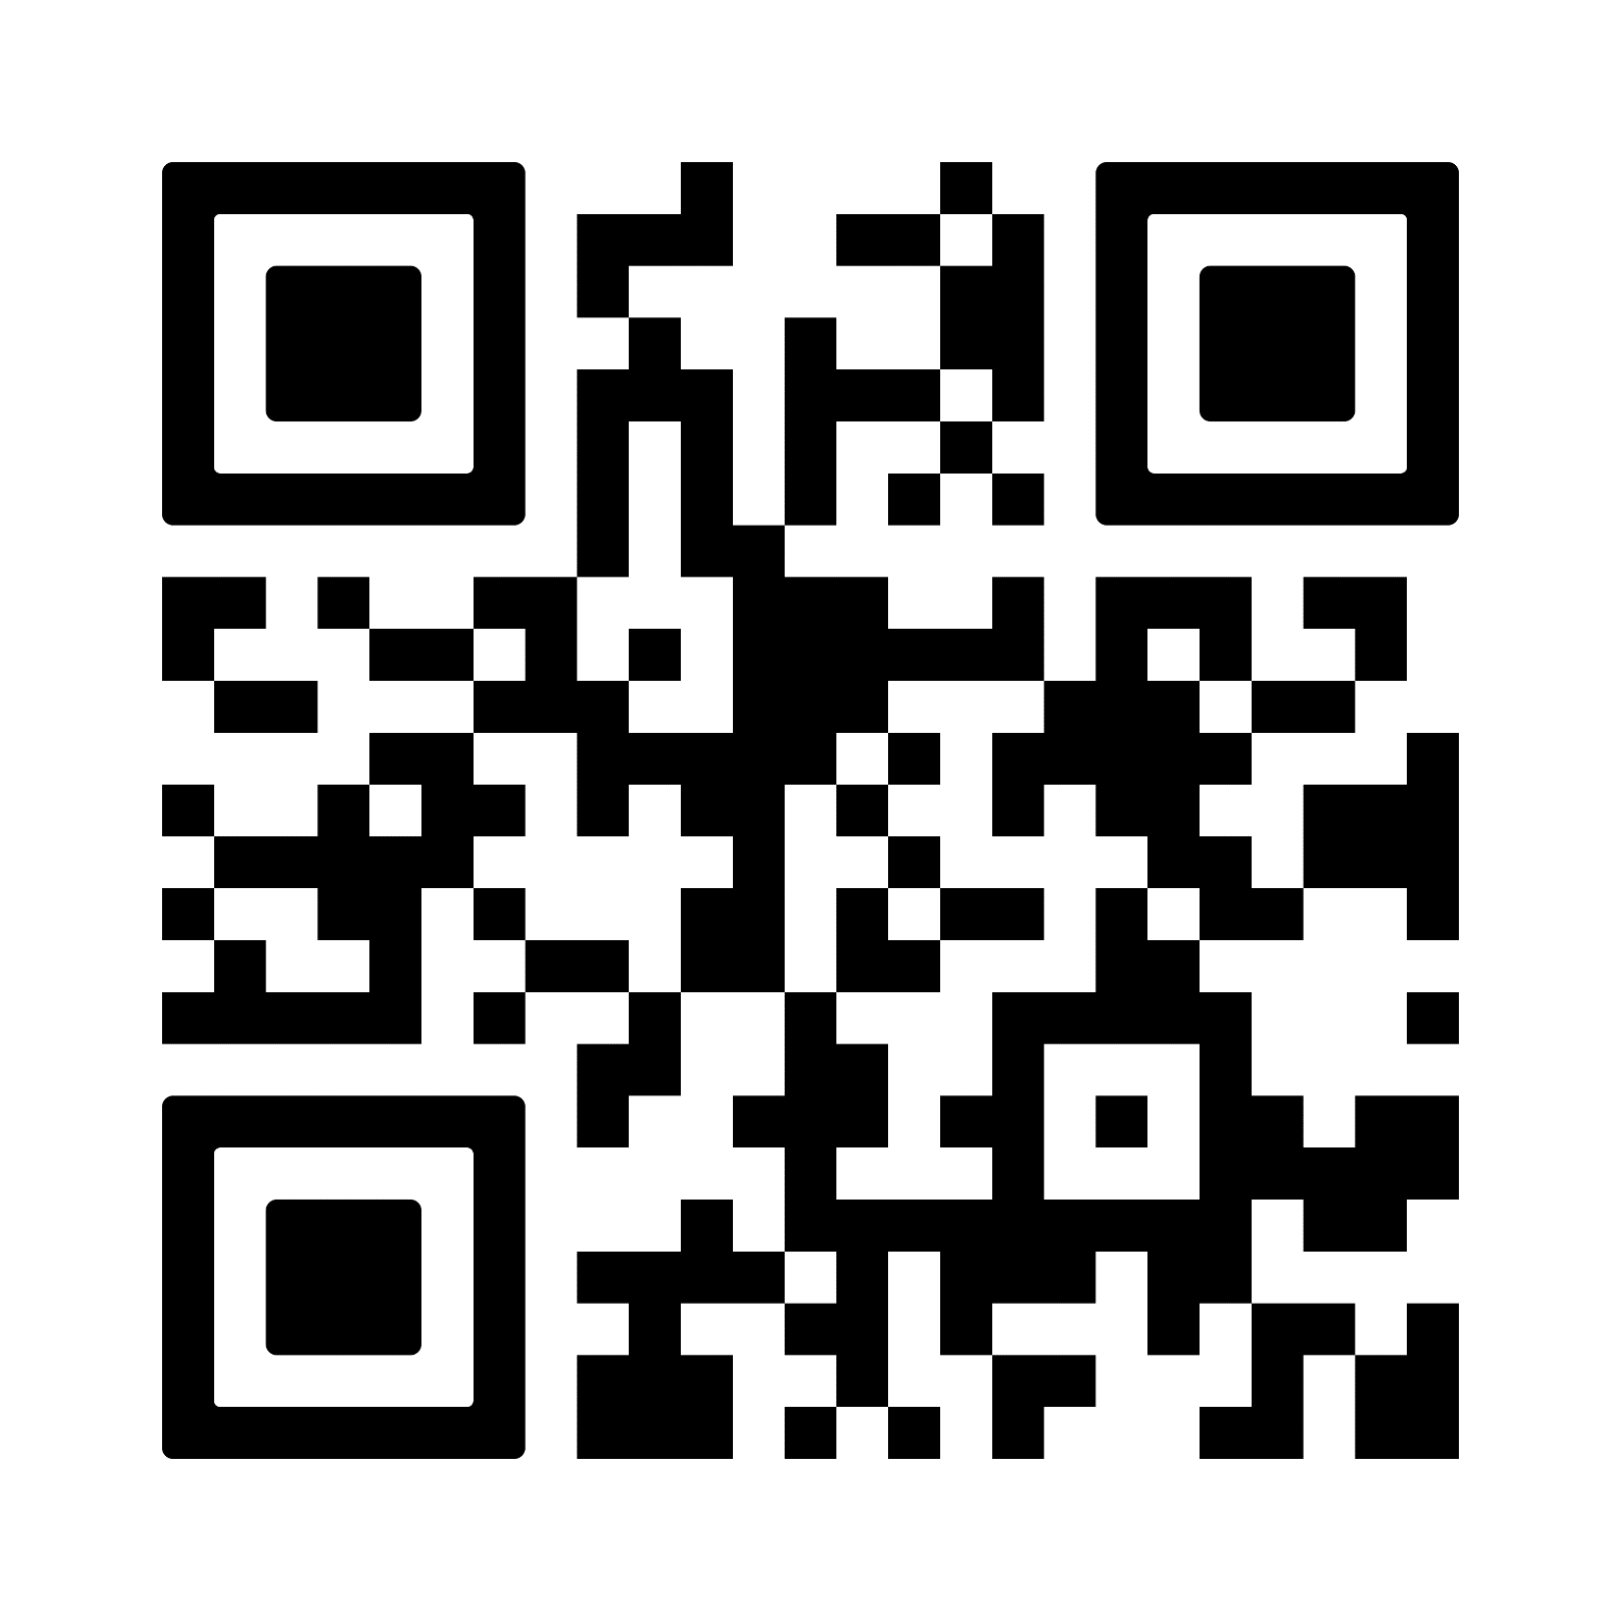
CPT Application Process
Register for the appropriate credits before applying for CPT
If you cannot receive course/research credits for the work experience, CPT cannot be authorized.
Appropriate types of credits that can be assigned for CPT include specific internship course credits, independent study credits, or research credits (if a specific internship course is not available).
Apply online prior to start of internship; should apply at least 7-10 days prior to start date.
UFIC ISS CPT Webpage

Slide 17
You must receive authorization on your I-20 prior to beginning any training/work!
You must not engage in any training/work without previously getting CPT approval to do so.
Failure to obtain CPT approval before beginning any training/work activity which requires CPT authorization will result in you falling out of status, with serious consequences.

Slide 18
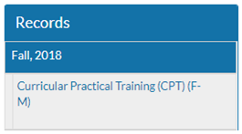
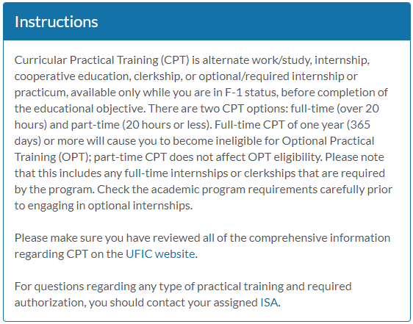
Applying for CPT
Apply online:
Read the information carefully
Click on the ISSS UF Login
Click on Curricular Practical
Training (CPT) (F-M)
Read/Follow/Upload/Complete:
Instructions,
Required Reading,
Attached Documents,
Questionnaire(s),
Recommendations, and
Signature Documents

Slide 19
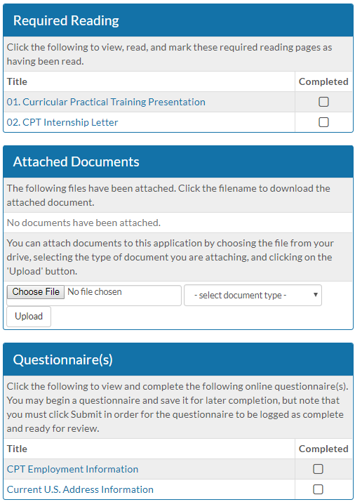
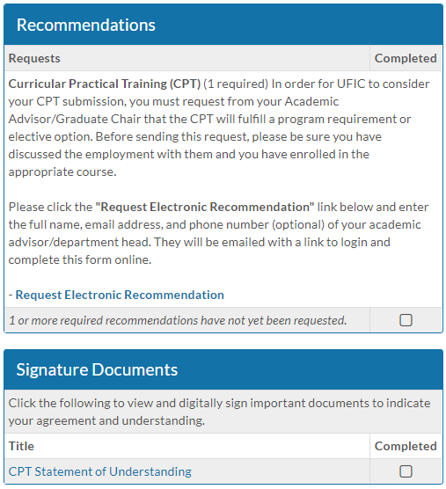
(At the TOP of the page!)

Slide 20
CPT Questions?
Scan the QR Code to learn more about CPT and to access the online application

Slide 21
Optional Practical Training (OPT)
PART 1:
What is OPT?
OPT Facts
Three Types of OPT
Pre-Completion
Post-Completion
STEM Extension OPT
Applying for OPT
OPT Reporting & Travel Requirements
STANDARD OPT

Slide 22
What is OPT?
Optional practical training is temporary employment authorization that allows F-1 students to gain practical work experience (on- or off-campus) by applying their academic knowledge to a position directly related to their area of study.
Standard OPT
Pre-Completion OPT
Available to all majors
Post-Completion OPT: 12 Months
Available to all majors

Slide 23
STANDARD OPT Facts
To be eligible, you must:
have completed at least one full academic year of study (fall and spring semesters only*),
have maintained legal immigration student status,
work in a position directly related to your field of study,
be in the U.S. to apply.
You do not need to have a job before you apply.
You can work on OPT before you graduate (pre-completion OPT) or after you graduate (post-completion); however, the guidelines are slightly different for each.
*summer semesters are considered vacation time for international students and do NOT count toward full academic year of study.

Slide 24
STANDARD OPT Facts, continued
May not exceed 90 aggregate days of unemployment
OPT is obtained through the US Citizenship and Immigration Service (USCIS).
You are only eligible for 12 months of full-time OPT for each higher degree level earned.*
If your OPT is approved you will be issued an EAD card, which you must have BEFORE you begin working.
Application fee for OPT is currently $410.

Slide 25
STANDARD OPT: Pre-Completion
Pre-completion OPT is granted to students who will work BEFORE graduation or program completion.
Your OPT cannot begin until after you have completed your first year of full time study (fall and spring semesters).
After you have completed the first academic year, the earliest you can apply for OPT is 90 days before you wish to begin working.
You must choose the start date for the OPT card at the time you apply.

Slide 26
STANDARD OPT: Pre-Completion, continued
Since you are working on OPT while you are still in school, you must be enrolled full-time (12 credits undergraduate/ 9 credits graduate).
You can only work 20 hours per week except during breaks from school, when you can work 40.
The time you work using pre-completion OPT takes away from the 12 months total OPT, deducted at a 50% rate.*
i.e.: If you work 4 months using pre-completion OPT, you will have taken away 2 months of post-completion OPT, leaving you with only 10 months of post completion OPT.

Slide 27
STANDARD OPT: Post-Completion
Post-completion OPT is granted to students who will work AFTER graduation/degree completion.
You choose the date you wish to begin working.
Start date MUST be within 60 days of graduation
You should apply for OPT BEFORE you graduate/finish coursework* or Clear Prior**
The earliest you can apply for post-completion OPT is 90 days before your graduation or completion date.
You must work at least 20 hours or more per week.

Slide 28
STANDARD OPT: Post-Completion, continued
USCIS does allow OPT application during the grace period, BUT the application MUST be at the USCIS office BEFORE the grace period is over and you must still choose an OPT start date within the grace period. The application will still require 60-90* days processing time.
*Currently taking USCIS 90-120 days to process
** Clear Prior: ONLY for PhD or Thesis Master’s students
You will finish degree requirements before the beginning of the next
semester, but will not actually graduate until
the end of that next semester.

Slide 29
Employer / Volunteer Info
Standard OPT is NOT restricted to an E-Verified Employer
Volunteering
USCIS allows volunteering on Standard OPT; counts toward maintaining status
Must still be directly related to your major
Must be at least 20 hours or more weekly
Obtain a “Letter of Commitment/Volunteer” for your records

Slide 30
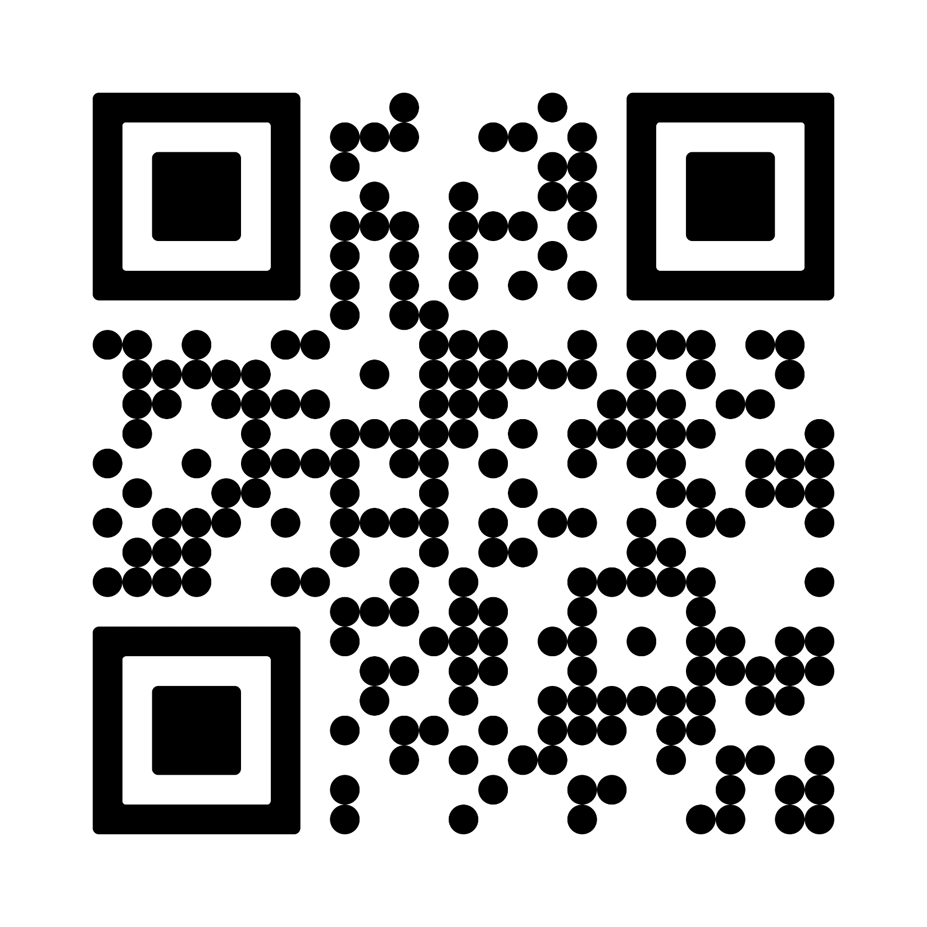
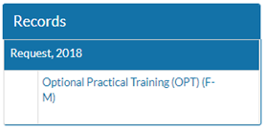
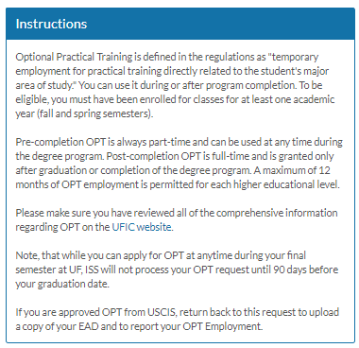
Apply for OPT
Read the information carefully
Click on the ISSS UF Login
Click on Optional Practical
Training (OPT) (F-M)
Read/Follow/Upload/Complete:
Instructions,
Required Reading,
Attached Documents,
Questionnaire(s),
Recommendations, and
Signature Documents
Please SCAN

Slide 31
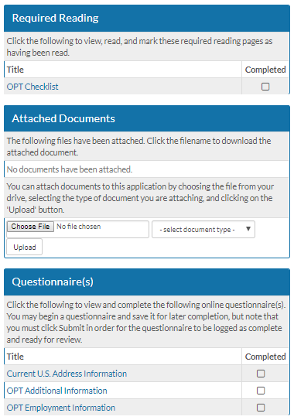
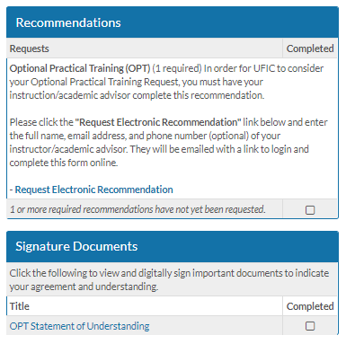
(At the TOP of the page!)

Slide 32
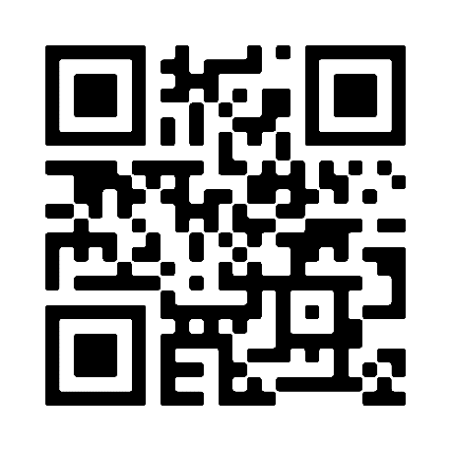
Apply for OPT Online with USCIS
Two passport-regulation photos which are less than 30 days old
Currently $410, payable with credit or debit card
I-765, Application for Employment Authorization
Scanned I-94
Scan of most recent F1 Visa (does not need to be valid)
Scan of Passport (must be valid/unexpired)
Scan of New I-20 with OPT recommendation on page two
(provided to you after we review your application in ISSS)
If applicable, any EAD cards or employment records from previous
jobs in the US
UFIC website – USCIS Application Process

Slide 33
Applying for OPT, continued
Apply online with USCIS at: https://www.uscis.gov/i-765
The receipt notice and the OPT card will be shipped to the address you provided on the I-765. Please scan and email a clear and legible copy of the OPT card to UFIC-ISS@ufic.ufl.edu when you receive it. Be sure to include your UFID number in the email.
If you cannot graduate/complete your program by the expected program end date on your OPT endorsed I-20, contact your ISA at UFIC BEFORE your I-20 expires to determine your options, if any.

Slide 34
Address Update, Employment Report, and Travel Requirements
while on Standard OPT

Slide 35
Address Update
You must update your address within TEN days of moving
You must provide a physical address location; it cannot be a P.O. Box.
Places to update your address:
OneUF: https://internationalcenter.ufl.edu/international-students-scholars/additional-information/change-address
USPS: https://www.usa.gov/post-office
USCIS: https://egov.uscis.gov/coa/displayCOAForm.do
If you move while your application is pending
SEVP Portal
Check GatorLink account for link emailed to you after your OPT is approved

Slide 36
OPT Reporting Information
SEVP Portal: If OPT is approved, you will receive email from SEVP regarding the SEVP OPT Portal on or around the start date on the OPT Card
The email will have a link to create your portal account. You must create the account within 14 days of receiving the email.
You must create and use the SEVP Portal account to report your information while on OPT
Update your personal information: home address, phone number, email, etc.
Any SEVP Portal issues, send email to
UFIC-ISS@ufic.ufl.edu and include your UFID#

Slide 37
OPT Reporting Information
You must report your employment within 10 days of your employment start date
Update your employment information:
- Employer/Company Name
- Employer/Company Address
- Job Title
- Full/Part time (must work at least 20 hours/week which is considered full time
- Employment Start Date (the day you started the job),
- Employment End Date (the day you ended the job, if your job offer has an end date or if you are ending one job and starting a new one)
“Relation to Field of Study: Explain how this job directly relates to the degree that qualified you for this OPT.”
Describe 3-5 of your job duties and explain how the employment is directly related to your major field of study.
Aim for 3-4 sentences, written as paragraphs, rather than list/bullet points.

Slide 38
Travel During OPT
You are still on an F1 Student Visa
Traveling out of the US is always risky, but if you choose to do so, in order to return to the U.S. you must have
Valid Passport (valid at least 6 months beyond entry date)
Valid F1 Student Visa
I-20 (which has been endorsed for OPT)
Valid travel signature (valid for 6 months from date signed)
Employment Authorization Document (EAD/OPT card)
Letter of Employment (on employer’s letterhead, stating your name, job title, brief description of duties, and a general idea of OPT start date; if you have already started, a letter confirming employment and knowledge of your travel plans)
2-3 recent pay stubs
*Dependents must have their own I-20, passport, F2 visa and copy of the F1’s I-20, OPT card and employment letter
**Not recommended to travel once I-20 expired and OPT is still pending

Slide 39
Standard OPT Questions?
Scan to access the UFIC I-20 OPT Recommendation webpage
UFIC website – USCIS online application information

Slide 40
STEM OPT 24-Month Extension
PART 2:
What is STEM OPT Extension?
STEM OPT Extension Eligibility
Application Process
Address Update, Employment Report, & Travel Requirements

Slide 41
OPT STEM Extension Eligibility
Available only to students who graduated with a U.S. Bachelor, Master, or Doctorate degree in a STEM (Science, Technology, Engineering, or Mathematics) major (refer to the CIP code listed on your I-20) on the DHS approved STEM Degree List
Can apply based on any previous STEM degree from an SEVP, accredited U.S. institution within the last 10 years immediately prior to your application.
Available twice per student’s lifetime

Slide 42
OPT STEM Extension Eligibility, continued
Must work in a paid position directly related to your major area of study
The employer must be registered in the
USCIS E-Verify Program with a valid E-Verify number, EIN number, be willing to complete the Form I-983, and abide by the Employers: STEM OPT Reporting Requirements
The student must agree to make periodic reports to the ISA every 6 months, or within 10 days of any changes in employment, home address, or name.

Slide 43
STEM OPT Eligibility, continued
Must be on a currently authorized, unexpired period of Standard Post-completion OPT
Must be in the U.S. to apply.
The earliest you can apply for STEM OPT is 90 days before your Standard Post-completion OPT expires
Begins on the day after the expiration of the standard post-completion OPT employment authorization and ends 24 months thereafter.
For example:
Standard OPT: 12/25/2021 – 12/24/2022
24-Month OPT STEM Extension: 12/25/2022 – 12/24/2024

Slide 44
STEM OPT Facts
Limited Periods of Unemployment to Maintain Status
During standard post-completion OPT, F-1 status is dependent upon employment.
May not exceed 90 aggregate/cumulative days of unemployment during the standard post-completion OPT
Students granted a 24-month OPT extension may not exceed an additional aggregate of 60 or more days of unemployment, for a total 150 days of unemployment during the total 36-month OPT/STEM OPT period.

Slide 45
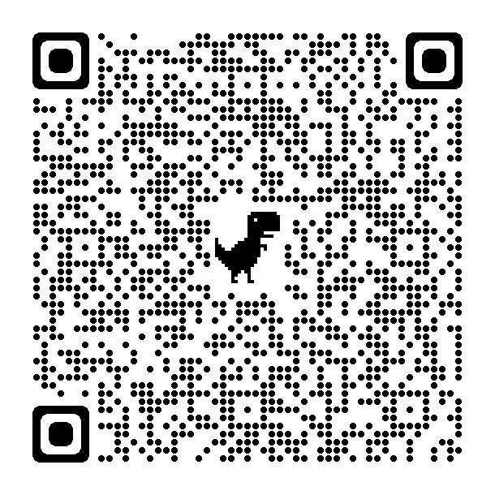
Employment Type Restrictions
Must be bona fide employees of the employer signing the Form I-983 Training Plan, and the employer that signs the Training Plan must be the same entity that employs the student and provides the practical training experience.
Types of employment which do not constitute bona fide employment:
volunteer/unpaid position,
self-employment/entrepreneurial arrangements,
sole proprietorship,
multiple employer arrangements,
Allowed two employers, 20 hours/week at EACH, minimum, both paid
employment “through” (vs. “at”) temp/staffing agencies are not encouraged
employment through consulting firm arrangements that provide “work/labor for hire,” (also known as 1099 employment) and
other relationships that do not constitute a bona fide employer-employee relationship.
USCIS website

Slide 46
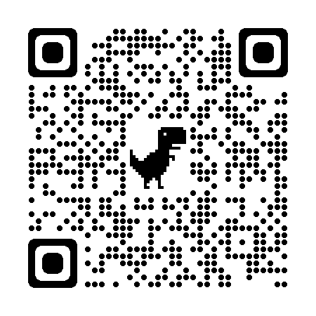
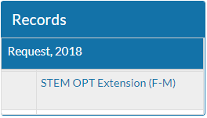
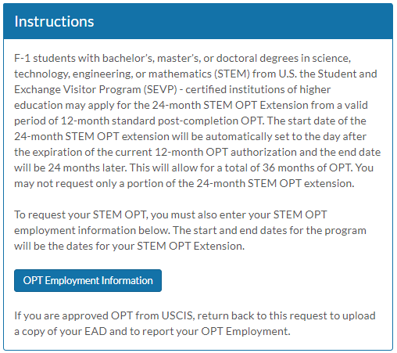
Apply for the STEM OPT Recommendation I-20
Read the information carefully
Click on the ISSS UF Login
Click on Optional Practical
Training (OPT) (F-M)
Read/Follow/Upload/Complete:
Instructions,
OPT Employment Info,
Required Reading,
Attached Documents,
Questionnaire(s), and
Signature Documents

Slide 47
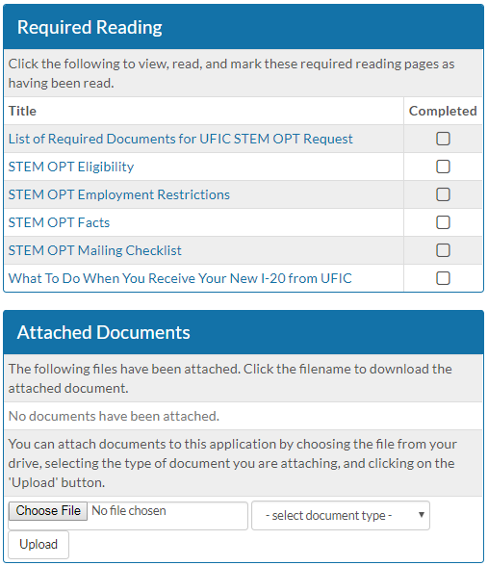
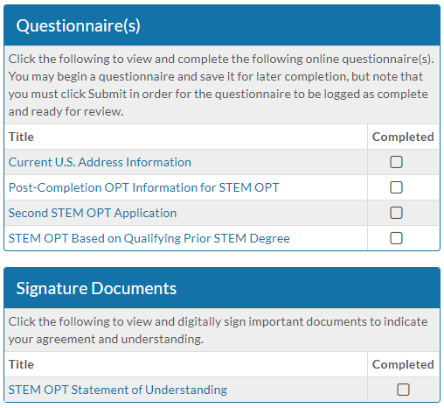
(At the TOP of the page!)

Slide 48
Applying for STEM OPT, continued
Your ISA will then input the 24-month STEM extension request in SEVIS and produce a new I-20 for you.
The STEM OPT I-20 will be provided to you to submit your application online with USCIS
Applications for the 24-month STEM extension must be receipted by USCIS BEFORE your standard OPT card expires.
Students who file a timely application for the 24-month OPT extension will be able to continue employment while the extension application is pending, until a final decision on the I-765 or for 180 days, whichever comes first.

Slide 49
Apply Online with USCIS
Two passport-regulation photos which are less than 30 days old
Currently $410 payable with credit or debit card
I-765 Form, Application for Employment Authorization
I-94 Upload
Scan of F1 Visa (does not need to be valid)
Scan of most recent Passport (must be valid/unexpired)
Scan of New I-20 with STEM OPT recommendation on page two
(provided to you after we review your application in ISSS)
Scan of Diploma and Official Transcripts
Scan of Standard OPT card or employment records from
previous jobs in the US

Slide 50
Applying for STEM OPT, continued
Apply online with USCIS at: https://www.uscis.gov/i-765
The receipt notice and the OPT card will be shipped to the address you provided on the I-765. Please scan and email a clear and legible copy of the OPT card to UFIC-ISS@ufic.ufl.edu when you receive it. Be sure to include your UFID number in the email.

Slide 51
Address Update, Employment Report, and Travel Requirements
while on STEM OPT

Slide 52
Address Update
You must update your address within TEN days of moving
You must provide a physical address location; it cannot be a P.O. Box.
Places to update your address:
OneUF: https://internationalcenter.ufl.edu/international-students-scholars/additional-information/change-address
USPS: https://www.usa.gov/post-office
USCIS: https://egov.uscis.gov/coa/displayCOAForm.do
If you move while your application is pending
SEVP Portal

Slide 53
STEM OPT Reporting Info
SEVP Portal may be used to update your personal information: home address, phone number, email, etc.
The SEVP Portal is not to be used by students on STEM OPT to update a change in employer
Must first report your employment info to your F-1 Advisor/DSO using the OPT Reporting Form and the I-983 Form. After the F-1 Advisor/DSO has reviewed and entered the employment info in SEVIS, you may use the SEVP Portal to update minor details regarding the specific STEM OPT employer that the F-1 Advisor/DSO has already entered in SEVIS.
If anything you wish to update in the portal differs from what was entered on the OPT Reporting Form and I-983 Form other than your own personal info, you must provide a new OPT Reporting Form and the I-983 Form to your F-1 Advisor/DSO, who will then review your updated documents and update SEVIS directly.
This will result in an updated I-20. You will be asked for mailing instructions when the I-20 is ready.

Slide 54
Travel During STEM OPT
You are still on an F1 Student Visa
Traveling out of the US is always risky, but if you choose to do so, in order to return to the U.S. you must have
Valid Passport (valid at least 6 months beyond entry date)
Valid F1 Student Visa
I-20 (which has been endorsed for STEM OPT)
Valid travel signature (valid for 6 months from date signed)
Employment Authorization Document (EAD/STEM OPT card)
Letter of Employment (on employer’s letterhead, stating your name, job title, brief description of duties, employment start date; a recent letter confirming employment and knowledge of your travel plans is also recommended)
2-3 recent pay stubs
* Dependents must have their own I-20, passport, F2 visa and copy of the F1’s I-20, OPT card and employment letter

Slide 55
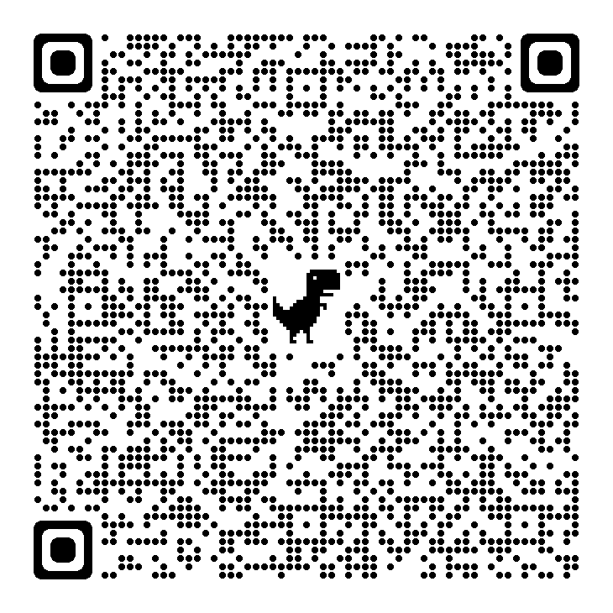
General STEM OPT Questions?
UFIC website – STEM OPT I-20 Application Information
UFIC STEM OPT Reporting Requirements

Slide 56
Contact Your International Student Advisor!
A-C |  | M-Q
Gardenia Bazan |  | Candice DeBose-Tyson
gbazan@ufic.ufl.edu |  | cdebose@ufic.ufl.edu
D-J |  | R-T
Ethel Porras |  | Yu “Yagi” Aoyagi
eporras@ufic.ufl.edu |  | yaoyagi@ufic.ufl.edu
K & L |  | U-Z
Steve Ghulamani |  | Kristin Fischer
sghulamani@ufic.ufl.edu |  | kfischer@ufic.ufl.edu

